Slide 1
Navasakam Grievance Management System
Gram -Ward Sachivalayam

Slide 2
Navasakam Grievance Management
Contents
Six Step Parameters
List of Grievances Categories
Workflow of Grievance Management
Different Modules in the portal
Q/A

Slide 3
Six Step Parameters
# | Parameter | Eligibility under the Parameter | Name of Department
 | Landholding of the family | Land holding of the family should be less than 3.00 acres of wet (or) 10.00 acres of dry (or) 10.00 acres of both wet and dry land together OR The extent of land as prescribed by the respective departments | Revenue
 | Property in municipal area | Family in municipal areas who owns house in less than 1000 sq. ft. site area | MAUD
 | Electricity Consumption | Monthly electricity consumption of a family dwelling unit (own/rent) should be less than 300 units per month | AP TRANSCO
 | Four-wheeler | Family should not own a motorized four-wheeler (Taxi, Tractors, Autos are exempted) | Transport
 | Caste | As per the respective scheme guidelines | Revenue
 | Age | As per the respective scheme guidelines | UIDAI (Aadhaar)
 | Gender | As per the respective scheme guidelines | UIDAI (Aadhaar)
 | Income Tax | No family member should be an Income Tax Payee Or Annual Income less than Rs 5,00,000 for Dr. YSR Aarogyasri Card | RTGS
 | Government Employee / Government Pensioner | No family member should be a Government employee or Government Pensioner In rural areas, Family having income up to Rs. 10,000/- per month i.e., Rs.1.20 lakh per year and in urban areas up to Rs. 12,000/- per month i.e., Rs.1.44 lakh per year from all sources of income | Finance
 | GSTN | As per the respective scheme guidelines | Commercial Tax
^{[1]} These are indicative parameters, however, for scheme wise details of the eligibility parameters

Slide 4
List of Grievance Category
Department:
All grievances pertaining to a department specific service shall be taken for consideration under this category.
  1. Land Records (Revenue)
  2. Urban Property (MAUD)
  3. Electricity Consumption (Energy)
  4. Vehicle (Transport)
  5. Caste (Revenue)
Aadhaar:
All grievances pertaining to Aadhaar based modification / update shall be taken for consideration under this category.
  1. Age
  2. Gender
Income:
All grievances pertaining to Income based modification / update shall be taken for consideration under this category.
  1. Income Tax
  2. Government Employee / Government Pensioner
  3. GSTN
Payment Failure:
All grievances pertaining to payment failure shall be taken for consideration under this category.
Others:
Any other grievances which may not be redressed in the above-mentioned category shall be taken for consideration under other grievance category.

Slide 5
Workflow of Grievance Management

Slide 6
Workflow of Grievance Management

Slide 7
Work flows
Income Tax/Government Employee
DA<Welfare Assistant <VRO<MRO<RDO<JC GSWS
GST
DA<WEA<MPDO<JC(GSWS)<DC Commercial Tax < JC(GSWS

Slide 8
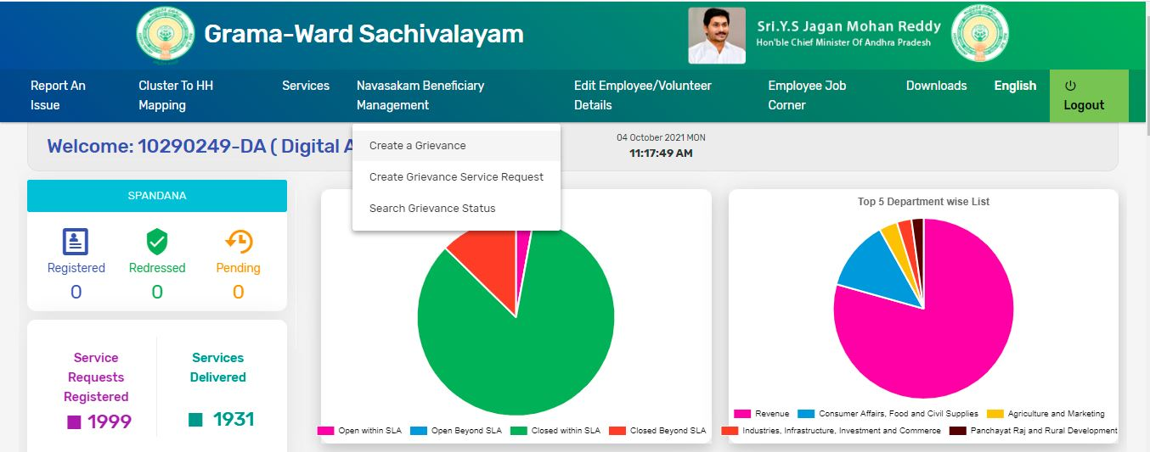
Different Modules in the portal
Create a Grievance
Create Grievance Service Request
Search Grievance Status

Slide 9
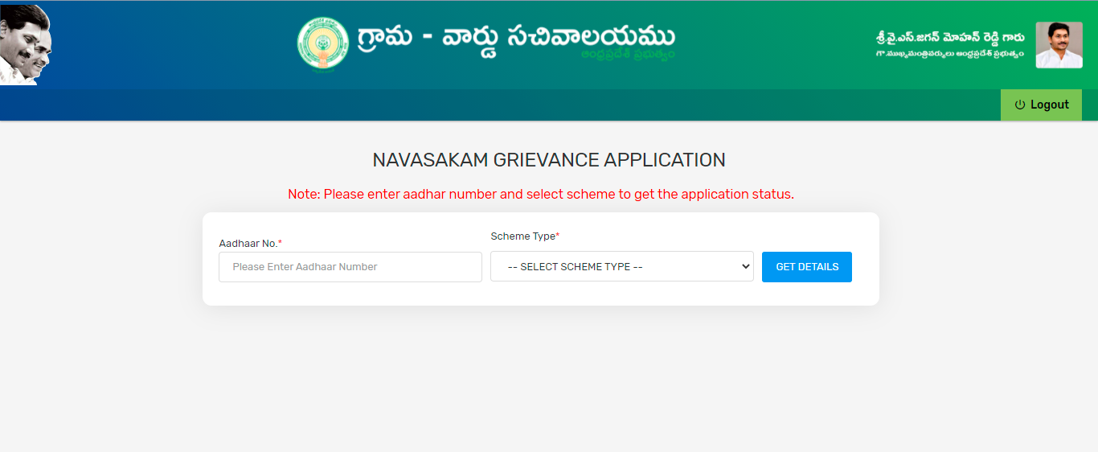
Create Grievance

Slide 10
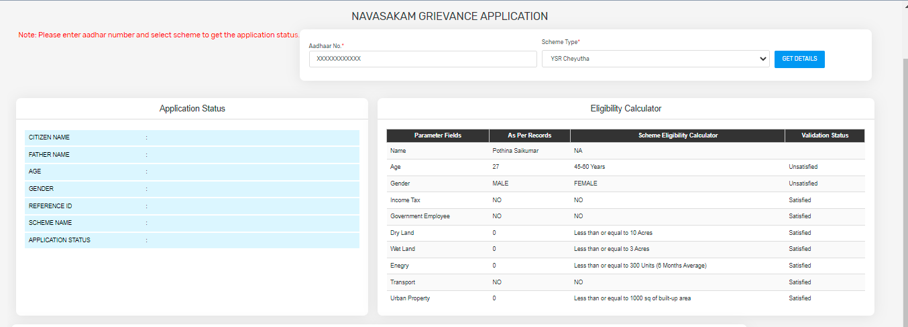
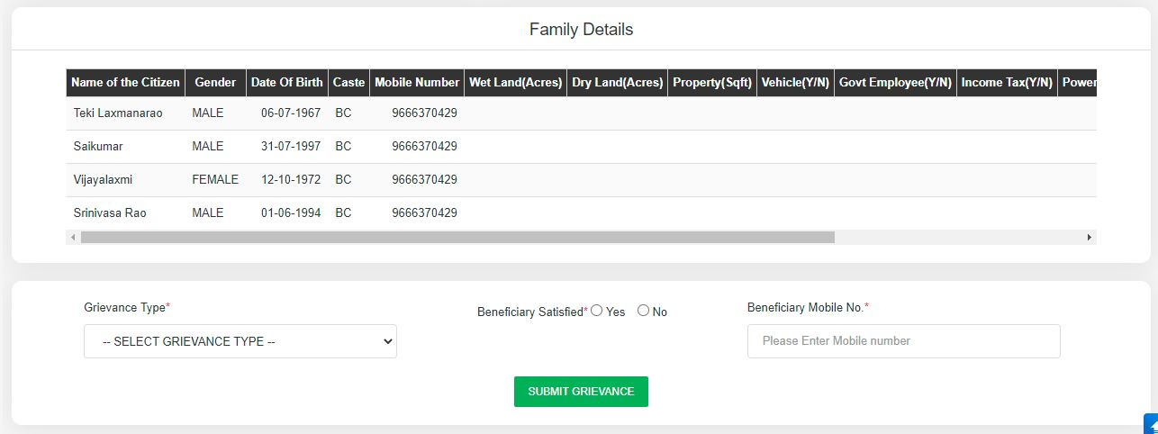
Grievance Application

Slide 11
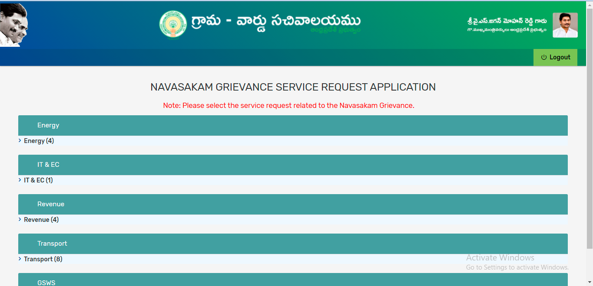
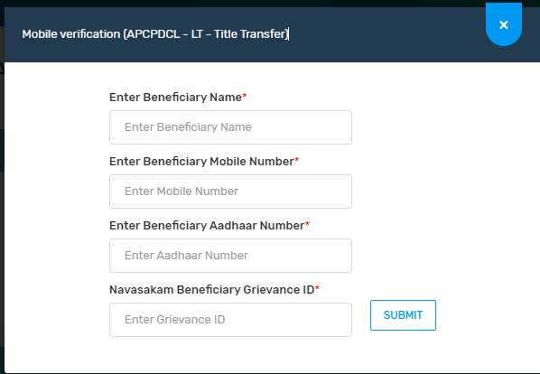
Grievance Service Request Application

Slide 12
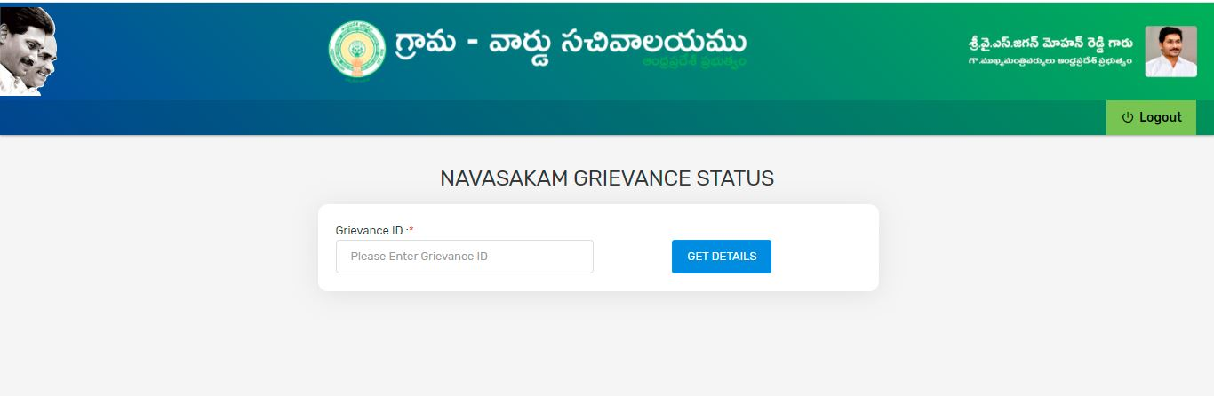
Grievance Status

Slide 13
Questions
Any Questions ….

